Slide 1
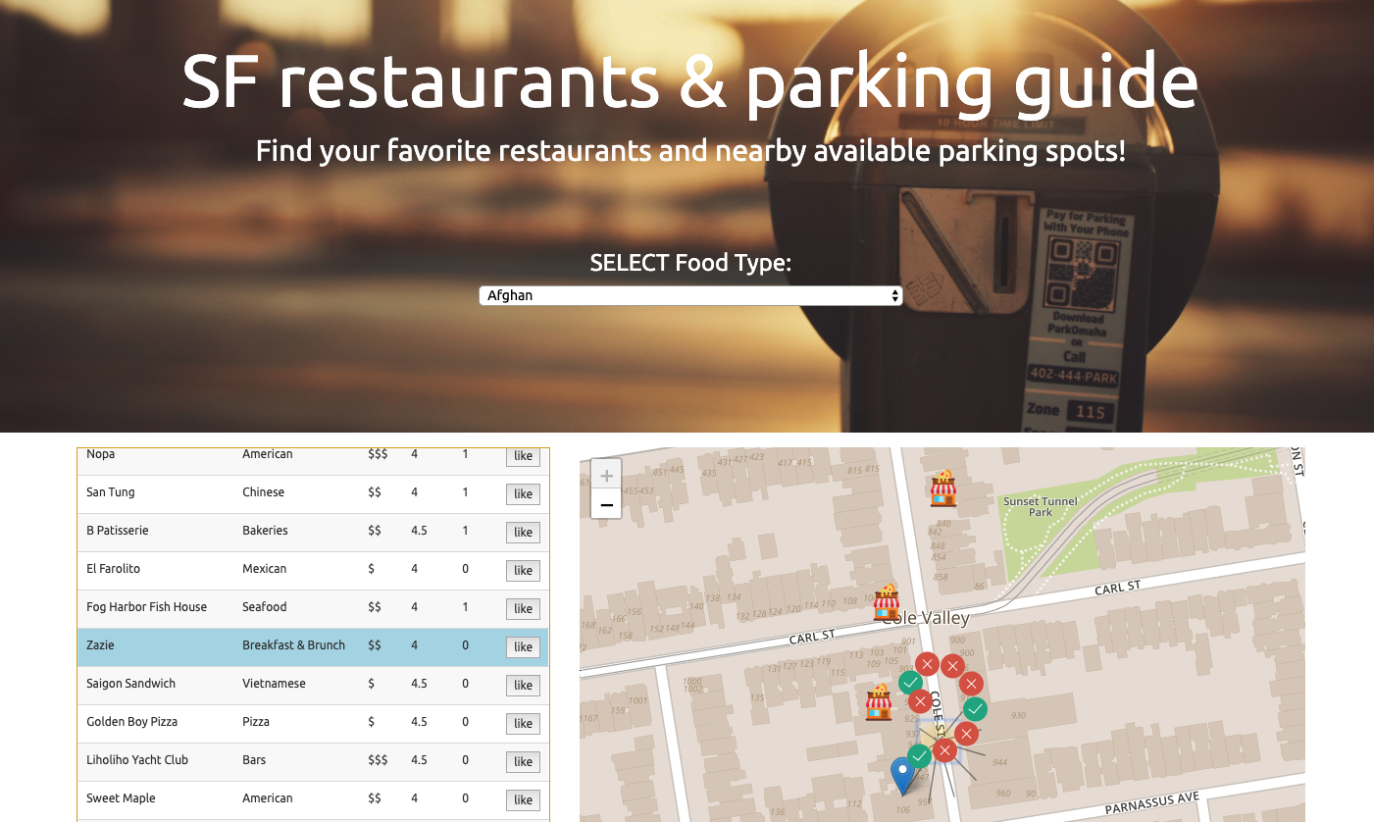

SF restaurants & parking guide
Find your favorite restaurants and nearby available parking spots!
Jinghua Yao, Junlin Chen
Danny Lou, David Wang

Slide 2
Project Goals
Restaurant Guide: We build a website that recommends local SF
restaurants to the users based upon different cuisine category, and
show nearby restaurants of the selected restaurant.
Meter Guide: In addition, based on the geo location of the selected restaurant, we will show its 10 nearby parking meters and their
parking availability status.
User Favorites: Users will be able to ”like” restaurants, data will be sent back and stored in our database, also updated on the map in
home page

Slide 3
ETL - Phase 1(Data Collection)
We perform the collection, integration and transformation of large volumes of parking meters data from San Francisco Open Data to and 1,000 restaurants’ data by calling yelp API.
Tools and Technic: Pandas, API request

Slide 4
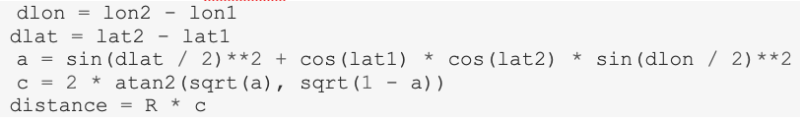
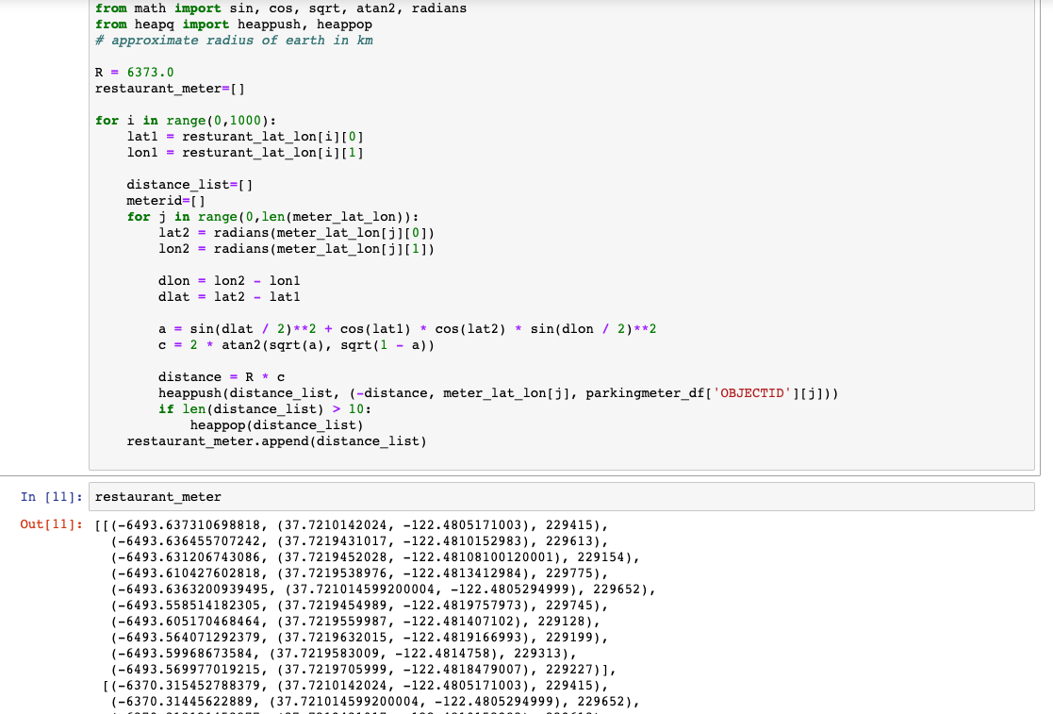
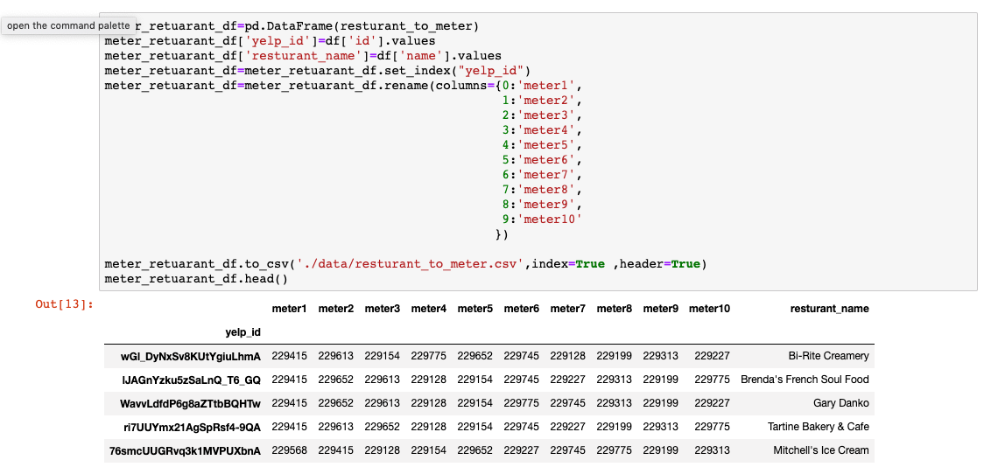
ETL - Phase 2 (Data Pair)
Our goal is to locate parking spots of each restaurant, base on the restaurant’s longitude and latitude, select the 10 closest ones to each specific coordinate set and store the data into relational database (SQLite). In order to collect the pairing data of the parking meters and restaurants, we import two python modules:
Tools and Technic: Math and Heapq. We use the following formula to calculate between each two coordinates

Slide 5
Tools And Techniques
Database – SQLite
JavaScript – D3, Plotly, Leaflet, jQuery(ajax)
Python –
Python Flask(jsonify, render_template, request, redirect, session),
flask_sqlalchemy,
Math, Heapq
OS, Pandas, NumPy, json
Sqlite3,
Requests,
Sqlalchemy(sqlalchemy.ext.automap, session, create_engine, inspect,
func, Column, Integer, String, update)
4. HTML, CSS, Bootstrap

Slide 6
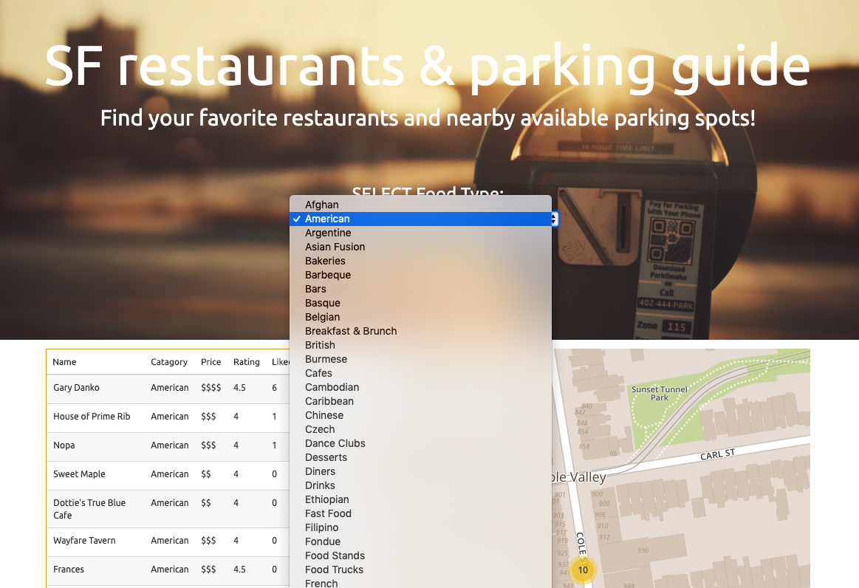
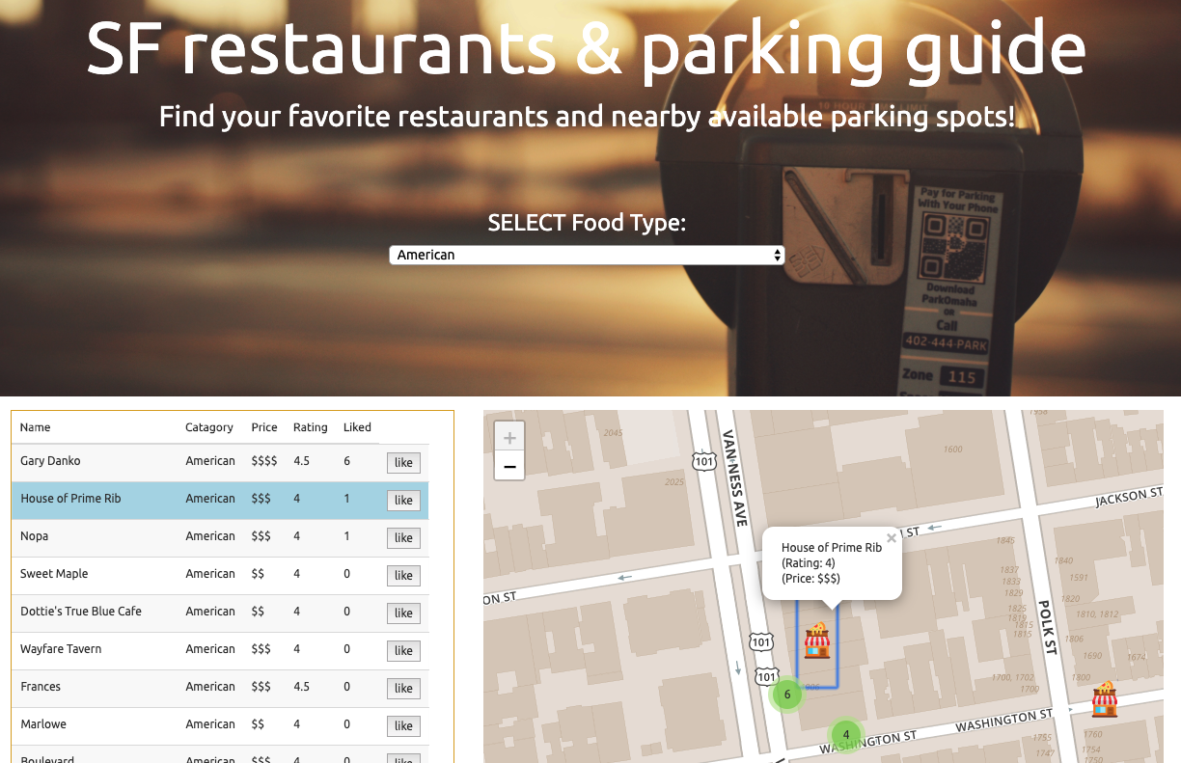
Product Design
Feature: Filter Select, Show Restaurants
Tool:D3.js, Leaflet

Slide 7
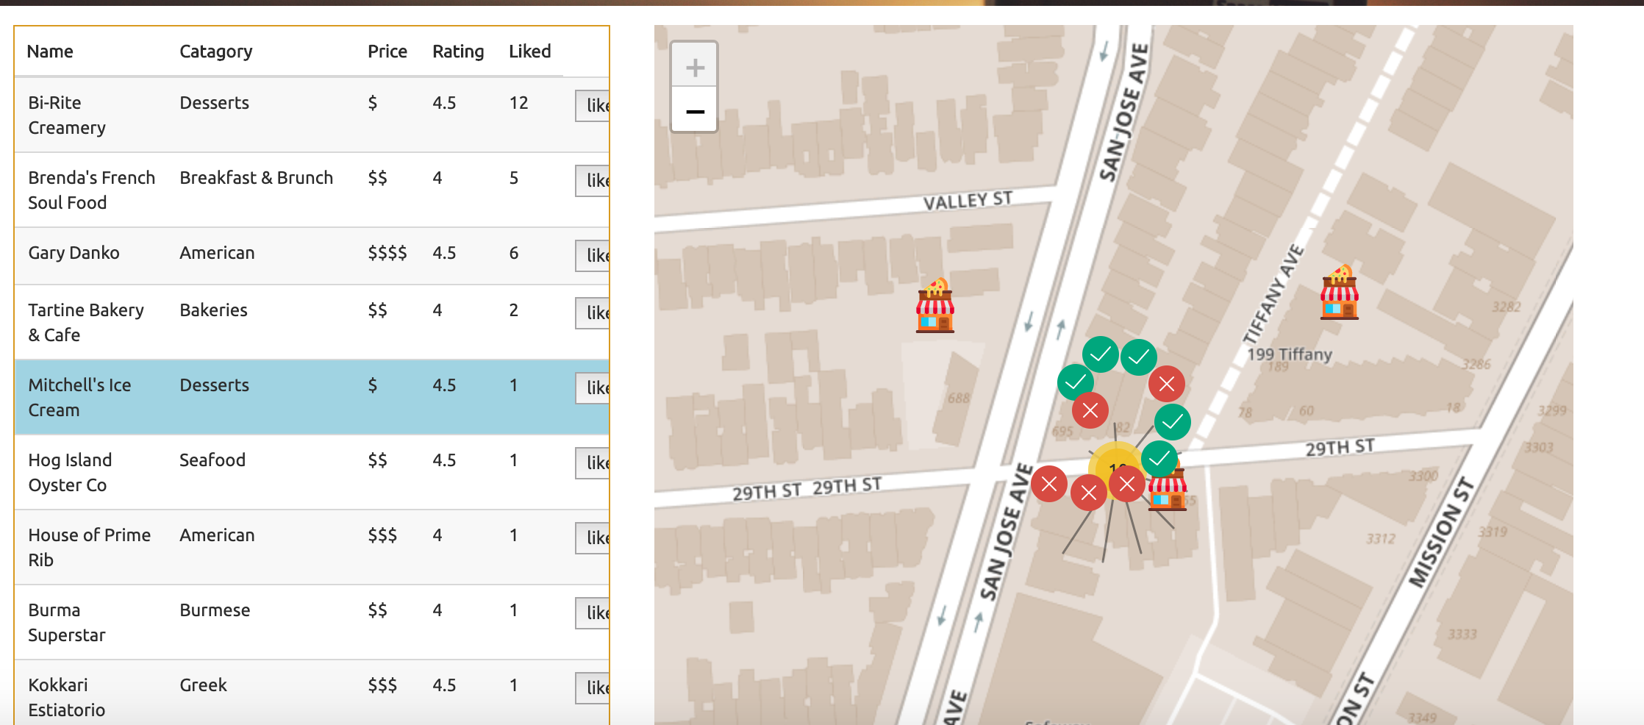
Product Design
Feature: Show Meters
Tool: leaflet

Slide 8
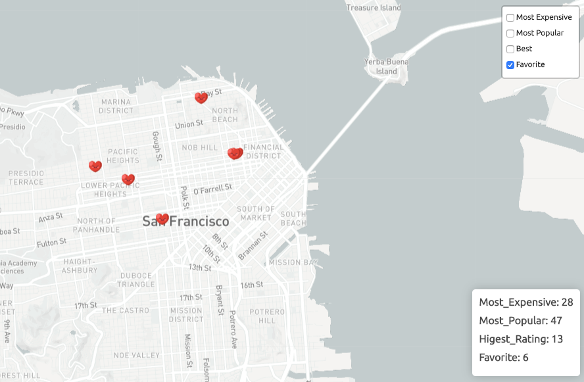
Product Design
Feature: Like Restaurants and Save to Favorite List
Tool: jQuery.ajax()

Slide 9
Demo

